Slide 1
Introducing…
The Faculty of Political Science

Slide 2
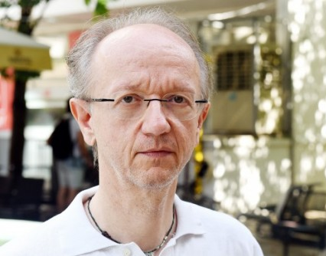
Zoran Kurelić, Full Professor With Tenure and Dean

Slide 3
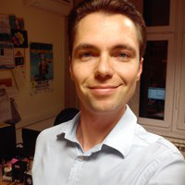
Zlatan Krajina, Assistant Professor and Vice-Dean for Science and International Cooperation
Consultation hours: Wednesday
12:30 - 13:00

Slide 4
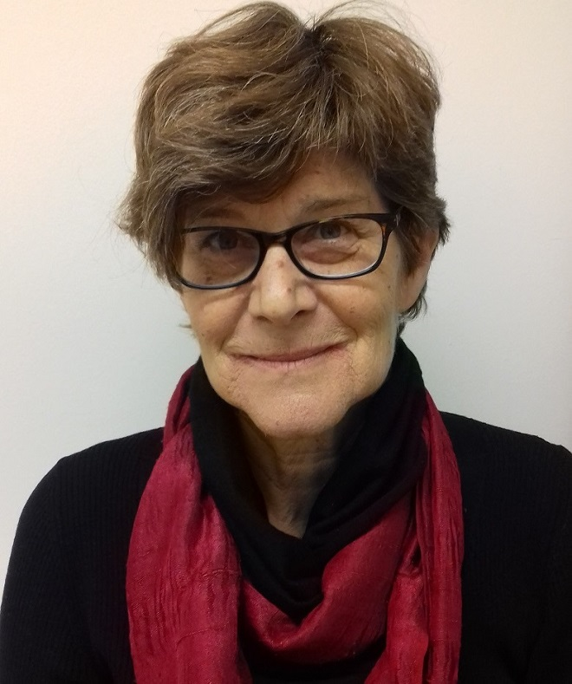
Gordana Vilović, Full Professor and Vice-Dean for Academic and Student Affairs
Media and Diversity
Master studies – 7 ECTS
First meeting: Tuesday, 05.03.
16:00
Room: 18 (4th floor)
Email: gordana.vilovic@fpzg.hr

Slide 5
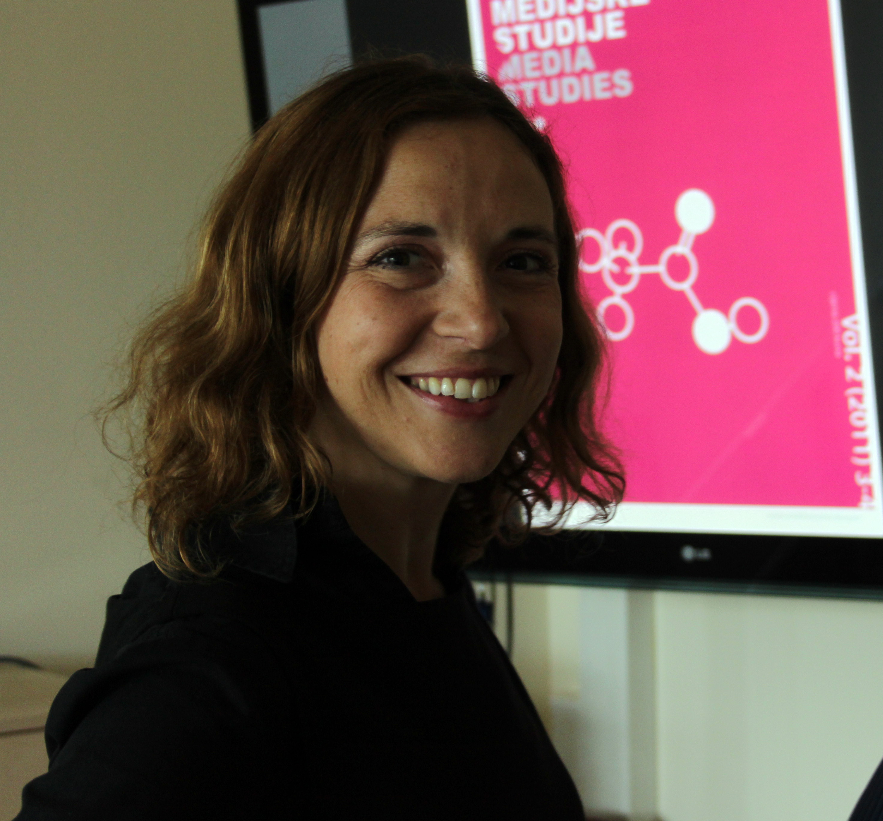
Viktorija Car, Associate Professor
Photojournalism
Bachelor studies – 5 ECTS
First meeting: Thursday, 28.02.
18:00
Room: D (2nd floor)
Email: viktorija.car@fpzg.hr

Slide 6
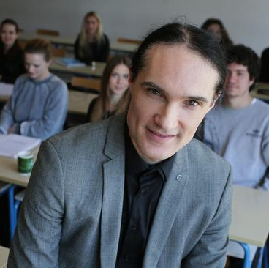
Hrvoje Cvijanović, Assistant Professor
Political Science Fiction: Political Ideas in Film and Fiction
Bachelor studies – 5 ECTS
First meeting: Thursday, 28.02.
17:15 – 20:30
Room: SEM I (3rd floor)
Email: hcvijanovic@yahoo.com

Slide 7
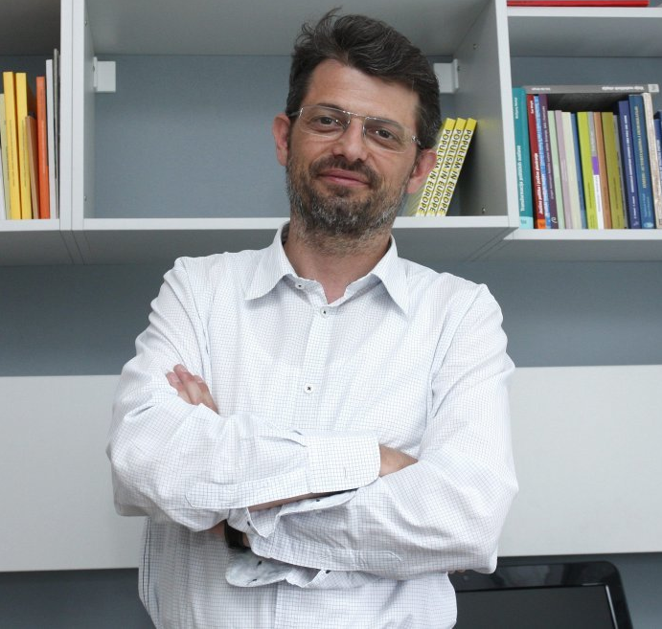
Goran Čular, Associate Professor
Party Competition and Party Systems in the EU Member States
Master studies – 7 ECTS
First meeting: Tuesday, 26.02.
10:15 – 13:30
Room: SEM I (3rd floor)
Email: goran.cular@fpzg.hr

Slide 8
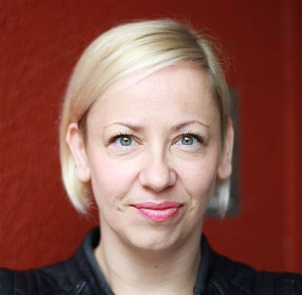
Danijela Dolenec, Assistant Professor
Protest Politics in Old and New Democracies
Bachelor studies – 5 ECTS
First meeting: Wednesday, 27.02.
12:00 – 15:15
Room: C (2nd floor)
Email: ddolenec@fpzg.hr

Slide 9
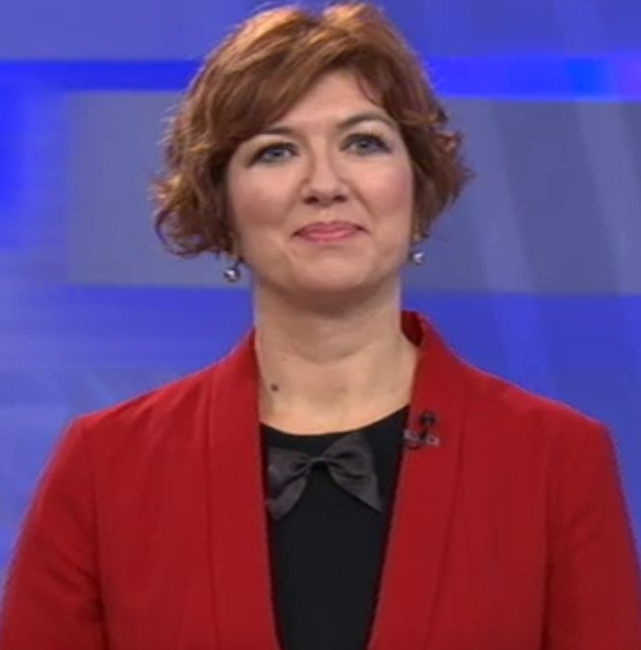
Marijana Grbeša-Zenzerović, Associate Professor
Pop Politics
Master studies – 7 ECTS
First meeting: Tuesday, 26.02.
13:45 – 17:00
Room: D (2nd floor)
Email: grbesa@fpzg.hr

Slide 10
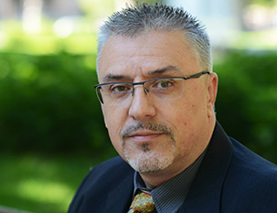
Boris Havel, Assistant Professor
Oriental Jews and Arabs in the time of Zionism
Bachelor studies - 5 ECTS
First meeting: Monday, 25.02.
15:30 – 18:45
Room: C (2nd floor)
Email: boris.havel@fpzg.hr

Slide 11
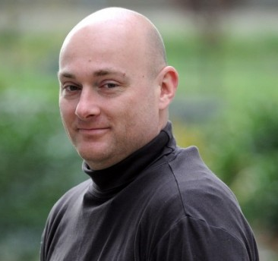
Andrija Henjak, Associate Professor
Party Competition and Party Systems in the EU Member States
Master studies – 7 ECTS
First meeting: Tuesday, 26.02.
10:15 – 13:30
Room: SEM I (3rd floor)
Email: andrija.henjak@fpzg.hr

Slide 12
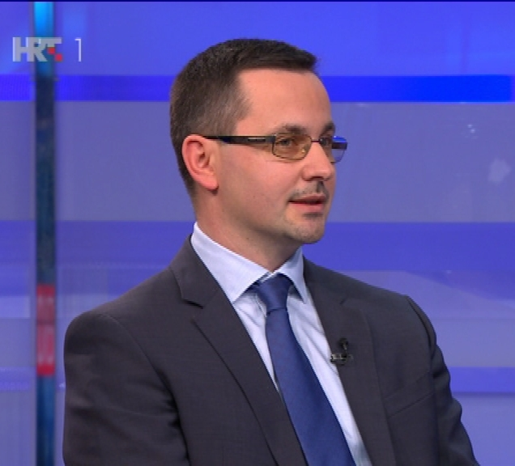
Igor Kanižaj, Associate Professor
Media and Violence
Bachelor studies - 5 ECTS
First meeting: Friday, 08.03.
12:00
Room: F4 (4th floor)
Email: igor.kanizaj@fpzg.hr

Slide 13
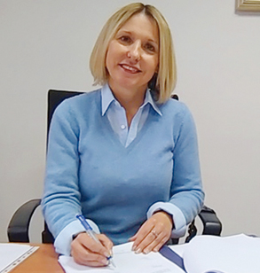
Lidija Kos-Stanišić, Full Professor
Latin America in International Relations
Master studies – 7 ECTS
First meeting: Wednesday, 27.02.
08:30
Room: 20 (4th floor)
Email: lidija.kos-stanisic@fpzg.hr

Slide 14
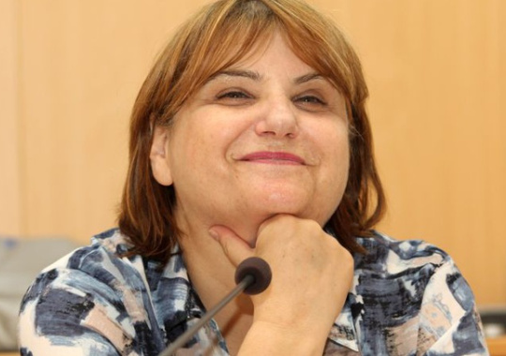
Tena Perišin, Associate Professor
TV Newsroom
Bachelor studies – 5 ECTS
First meeting: Monday, 25.02.
15:00
Room: TV studio (basement)
Email: tena.perisin@fpzg.hr

Slide 15
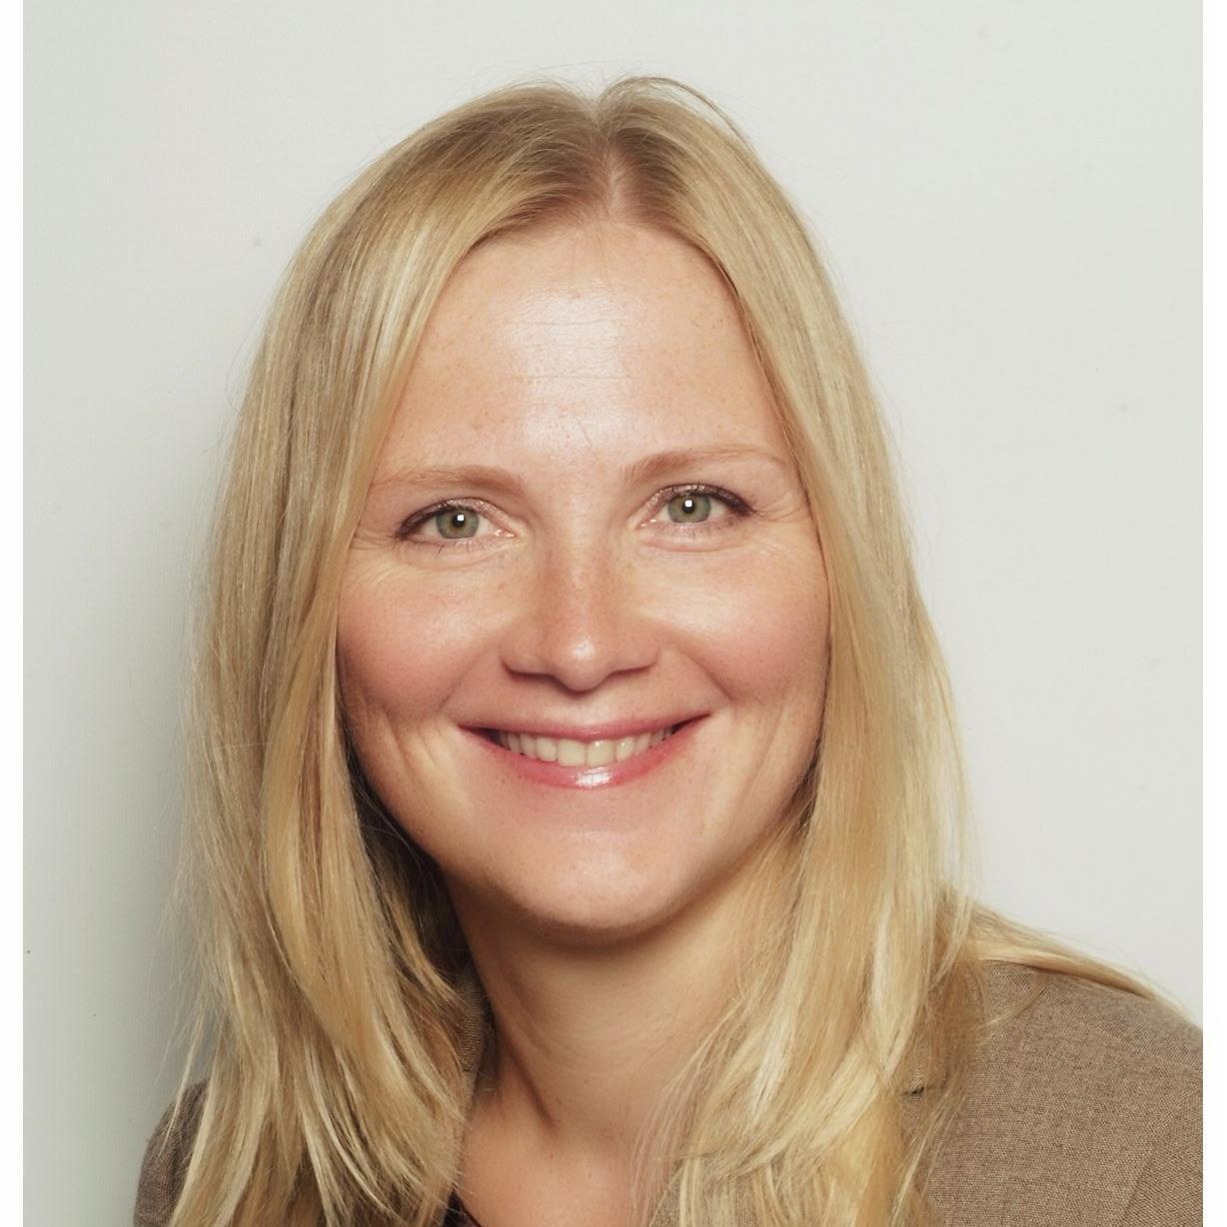
Dagmar Radin, Associate Professor
Development Policy
Master studies – 7 ECTS
First meeting: Thursday, 28.02.
12:00 – 15:15
Room: Seminar V (4th floor)
Email: dradin@fpzg.hr

Slide 16
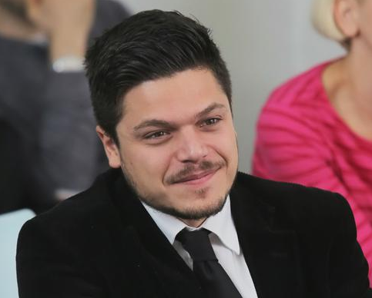
Višeslav Raos, Assistant Professor
Electoral Systems
Bachelor studies – 5 ECTS
First meeting: Wednesday, 06.03.
10:15
Room: F3 (3rd floor)
Email: viseslav.raos@fpzg.hr

Slide 17
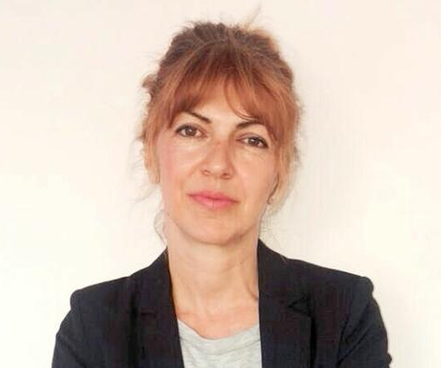
Davorka Vidović, Assistant Professor
Sociology of Croatian Society
Bachelor studies – 5 ECTS
First meeting: Wednesday, 06.03.
15:30
Room: F3 (3rd floor)
Email: dvidovic@fpzg.hr

